Slide 1
Weekly report: Tower structure
Week number: 11
Date: 09/12/2025
Supervisor: Prof. Faber
Group members: Ibrahim Mostafa, Mohammed Eldemerdash, Kirollos Ghaly
Speaker: Mohammed Eldemerdash (760137)
09/12/2025
1
Speaker: Mohammed Eldemerdash (760137)
Tower structure team/ Optimus Syria

Slide 2
List of contents
Redesign the flange connection
Design the door opening.
Function and challenges of the door opening
Loads and stresses that affect the opening
Solutions for supporting the tower shell
The reinforcement of the tower opening
09/12/2025
2
Speaker: Mohammed Eldemerdash (760137)
Tower structure team/ Optimus Syria

Slide 3
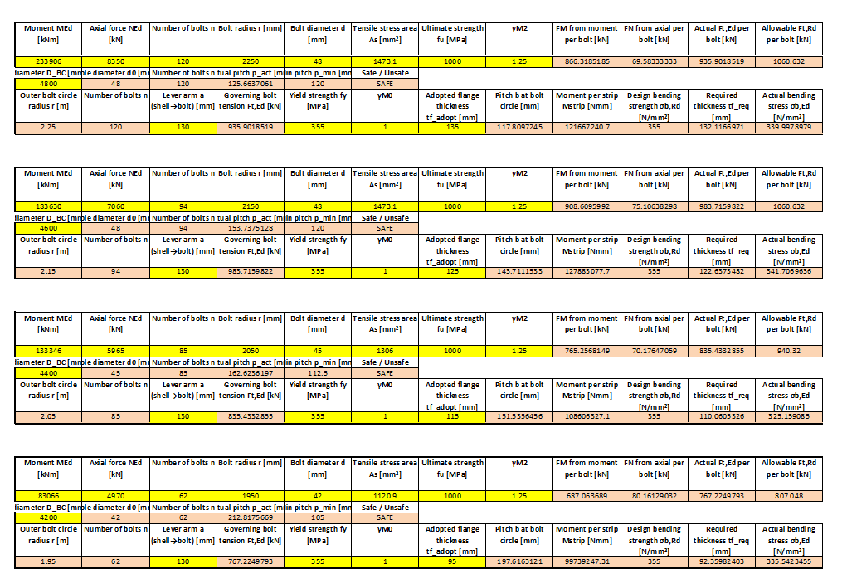
Design the flange connection
09/12/2025
3
Speaker: Mohammed Eldemerdash (760137)
Tower structure team/ Optimus Syria

Slide 4
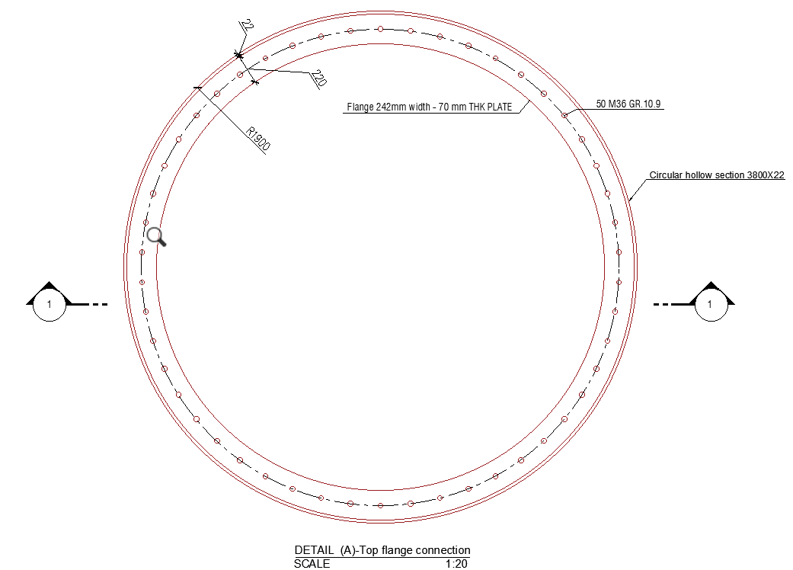
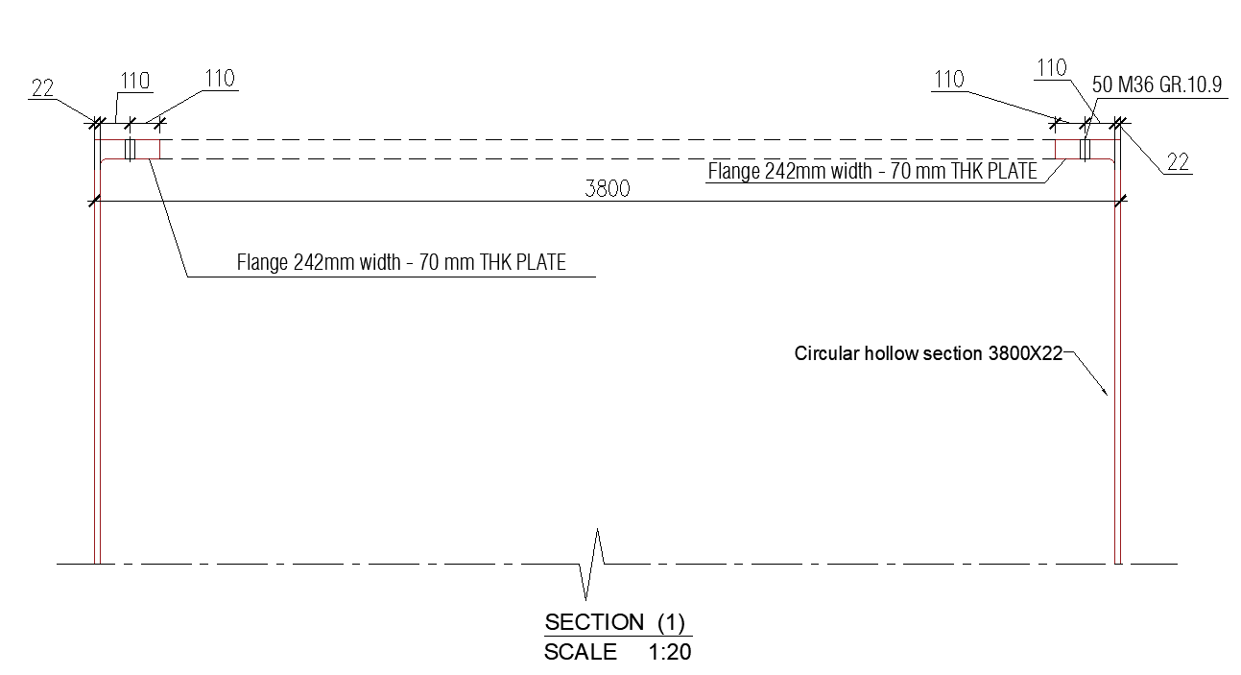
Design the flange connection
09/12/2025
4
Speaker: Mohammed Eldemerdash (760137)
Tower structure team/ Optimus Syria

Slide 5
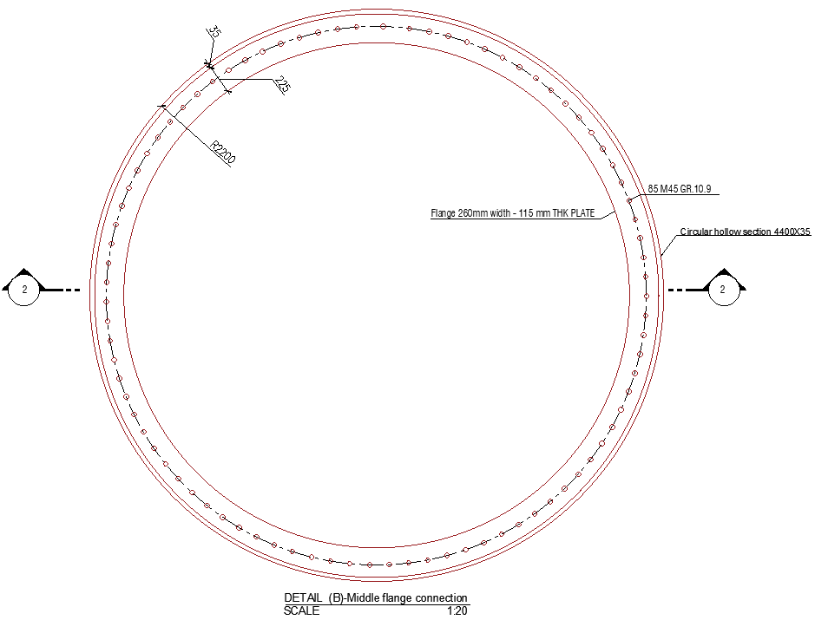
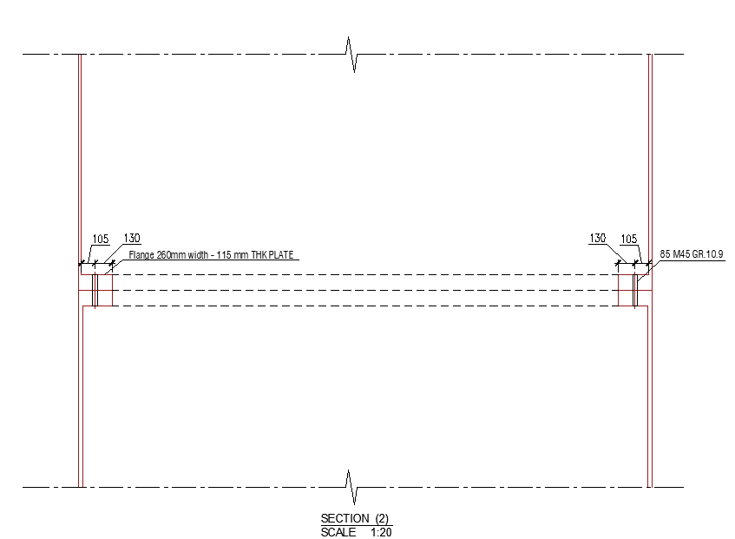
Design the flange connection
09/12/2025
5
Speaker: Mohammed Eldemerdash (760137)
Tower structure team/ Optimus Syria

Slide 6
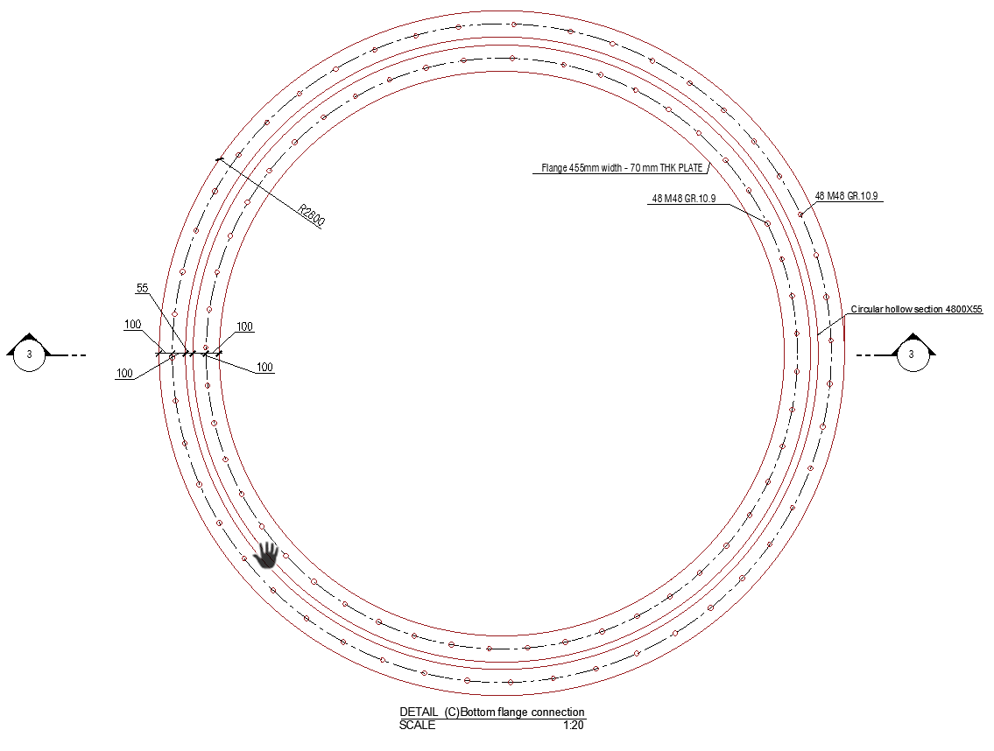
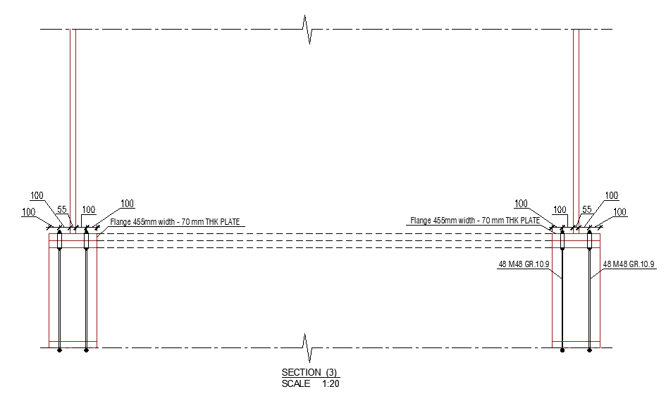
Design the flange connection
09/12/2025
6
Speaker: Mohammed Eldemerdash (760137)
Tower structure team/ Optimus Syria

Slide 7
Design the flange connection
Joint | Flange Location | Bolt Size | Bolt Grade | Number of Bolts (total) | Flange Width | Flange Thickness
J1 | Base | M48 | 10.9 HV | 96 Anchor bolts | 455mm | 120 mm
J2 | 20 m joint | M48 | 10.9 HV | 120 | 260mm | 135 mm
J3 | 40 m joint | M48 | 10.9 HV | 94 | 260mm | 125 mm
J4 | 60 m joint | M45 | 10.9 HV | 85 | 260mm | 115 mm
J5 | Top joint | M42 | 10.9 HV | 62 | 260mm | 95 mm
J6 | Top joint | M36 | 10.9 HV | 42 | 242mm | 70 mm
09/12/2025
7
Speaker: Mohammed Eldemerdash (760137)
Tower structure team/ Optimus Syria

Slide 8
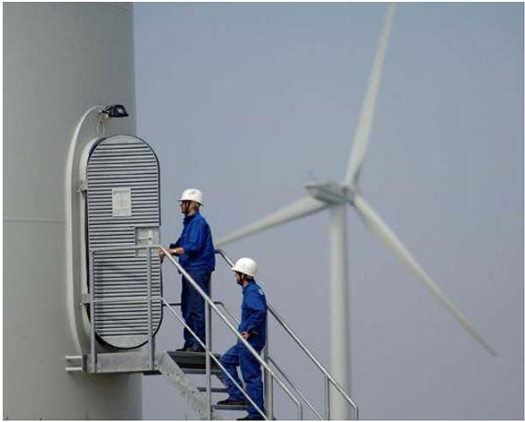
Function and challenges of the door opening
• Provides personnel access, emergency exit, and equipment handling
• Cut-out reduces tower shell strength → reinforcement required
• Key loads: global tower axial + bending, wind pressure, pressure difference, fatigue, buckling
• Critical issues: stress concentration, local buckling, weld fatigue, door deflection/sealing
• Safety provisions: internal opening, corrosion protection, regular inspection
Fig: Typical door opening in a wind turbine
IJRET
Speaker: Mohammed Eldemerdash (760137)

Slide 9
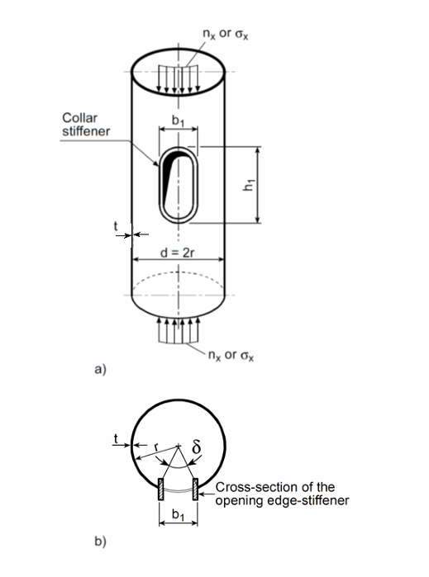
Loads and stresses that affect the opening
Horizontal forces:-
FH = F_{H1} + F_{H2 =} 356 kN
Vertical forces:-
FV = F_{v1} + F_{v2 =} 9807 kN
Moments:-
M = M_{thrust} + M_{drag tower2} + M_{nacelle =} 284000 kN.m
Axial stress :-
σa= FV / A- tower sec 11.88 N/mm²
Bending Stress
σb =- (M / Io )* (D-out / 2 ) 309.8 N/ mm²
Combined Stress
Fk= σa +σb 321.7 N/ mm²
Allowable stress :-
fd = fk / γ M 322 N/ mm²
u = (Fk*γ M) / fd < 1 0 .085 < 1
Figure: Circumferentially edge-stiffened openings
DNVGL-ST-0126
Figure: forces and moments on the turbine
Tower structure lecture notes
Speaker: Mohammed Eldemerdash (760137)

Slide 10
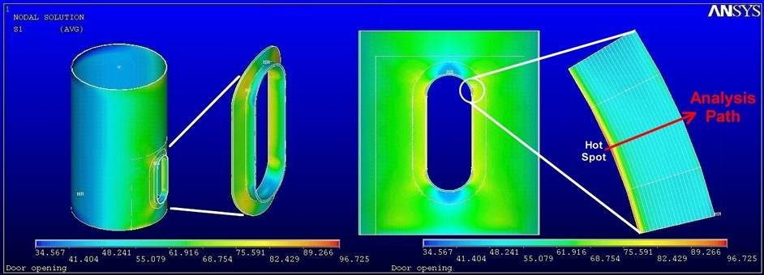
Solutions for supporting the tower shell
• Reinforcement solutions: doubler plates, rounded corners, Circumferentially edge-stiffened openings
• Verification: hand checks (stress + buckling), detailed FEA, fatigue assessment, functional/sealing tests
• Hardware sizing: hinges, locks, seals designed for wind forces and durability
Fig: stress concentration and results of the Finite Element Calculation
Prof. Dr.-Ing. Torsten Faber’s Tower structure lecture notes
Speaker: Mohammed Eldemerdash (760137)

Slide 11
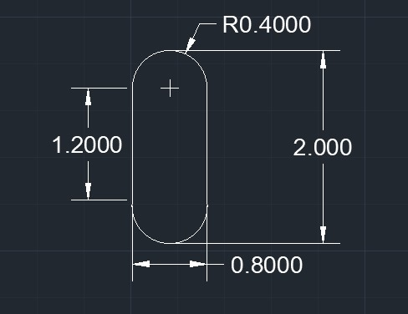
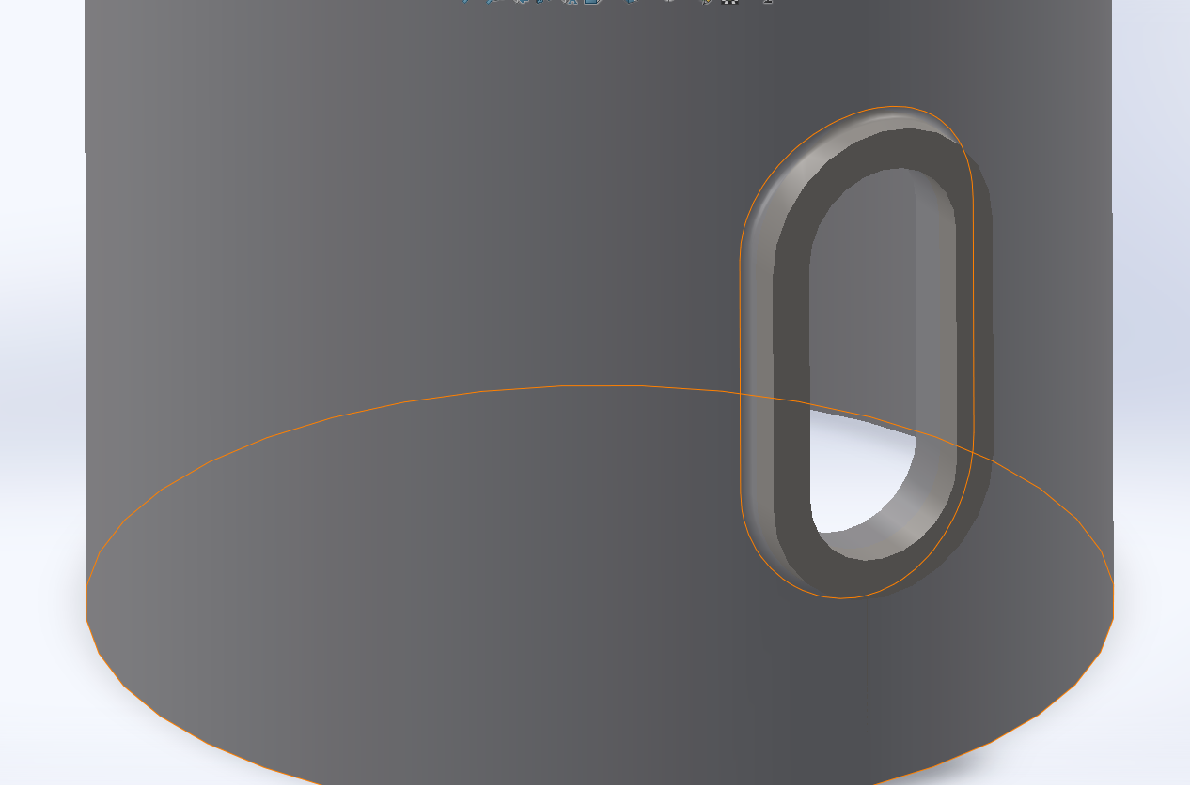
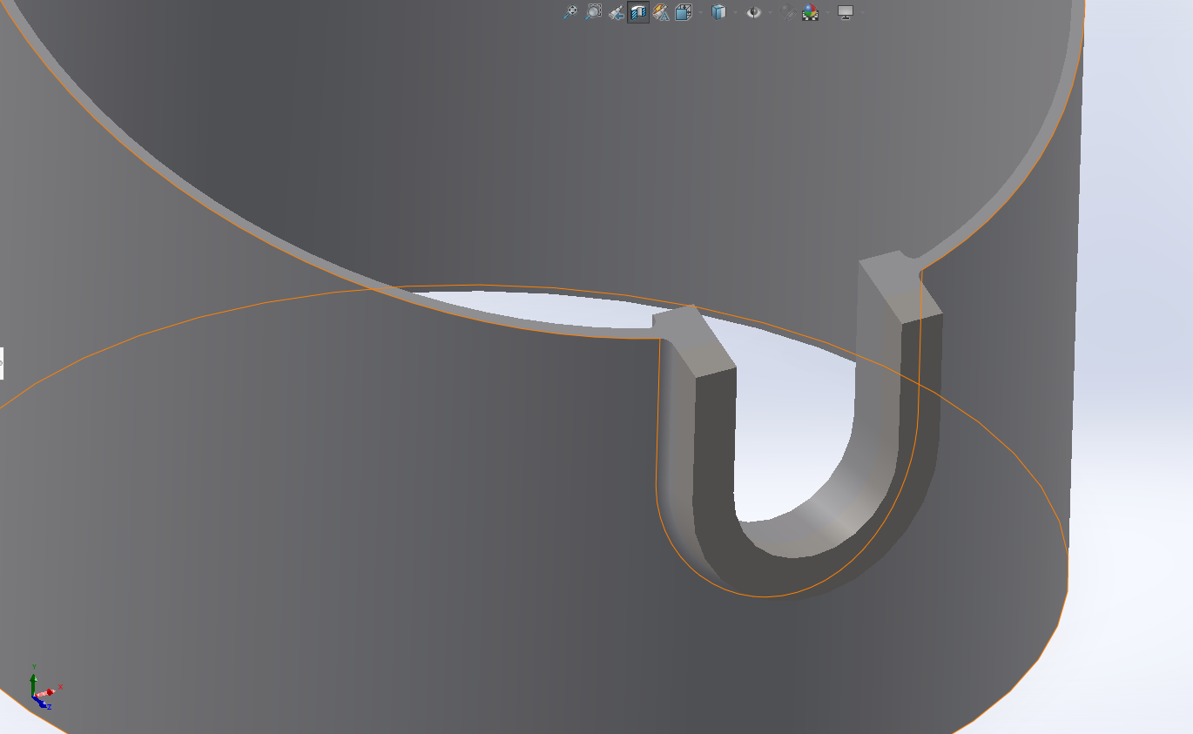
The reinforcement of the tower opening
Fig: Circumferentially edge-stiffened reinforcement
Personal CAD drawing and modeling using Auto CAD and SolidWorks
Speaker: Mohammed Eldemerdash (760137)

Slide 12
The next task
Design the door opening.
09/12/2025
12
Speaker: Mohammed Eldemerdash (760137)
Tower structure team/ Optimus Syria

Slide 13
References
https://www.nrel.gov/wind/data-tools
IJRET20140305090.pdf
DNVGL-ST-0126 Support structures for wind turbines 07-2018.pdf
002+Tower+Structures+WS+2025+WM.pdf
09/12/2025
13
Speaker: Mohammed Eldemerdash (760137)
Tower structure team/ Optimus Syria

